Slide 1



ACV-SI-04: Using Interactive LED Lights to Engage, Do and Learn
Catherine Rose, Philips Color Kinetics
Judy Vesel, TERC
Joe Martini, Perkins Products
January 30, 2013

Slide 2
Agenda
9:20-9:30 Introduction Catherine Rose
9:30-9:50 User Testing Judy Vesel
9:50-10:05 Market Opportunities Joe Martini
10:05-10:15 Demonstration Catherine Rose
10:15-10:20 Questions All

Slide 3
LightAide Introduction
Presented by
Catherine Rose, Mom & Product Manager
Philips Color Kinetics
Catherine.Rose@Philips.com

Slide 4
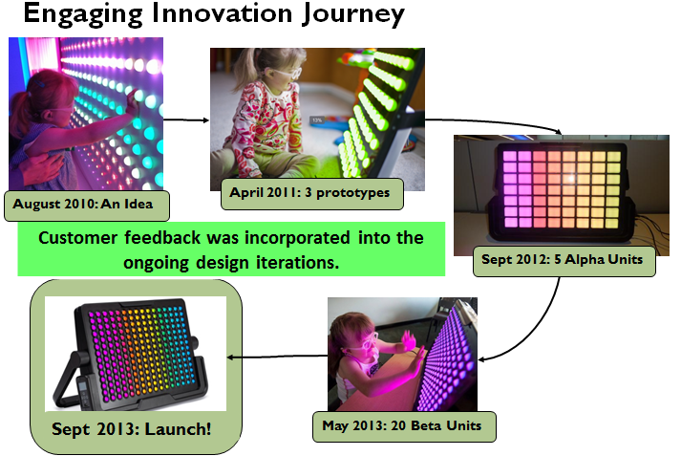

Slide 5
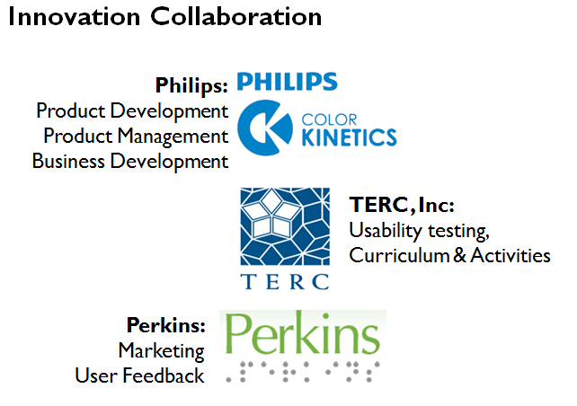

Slide 6
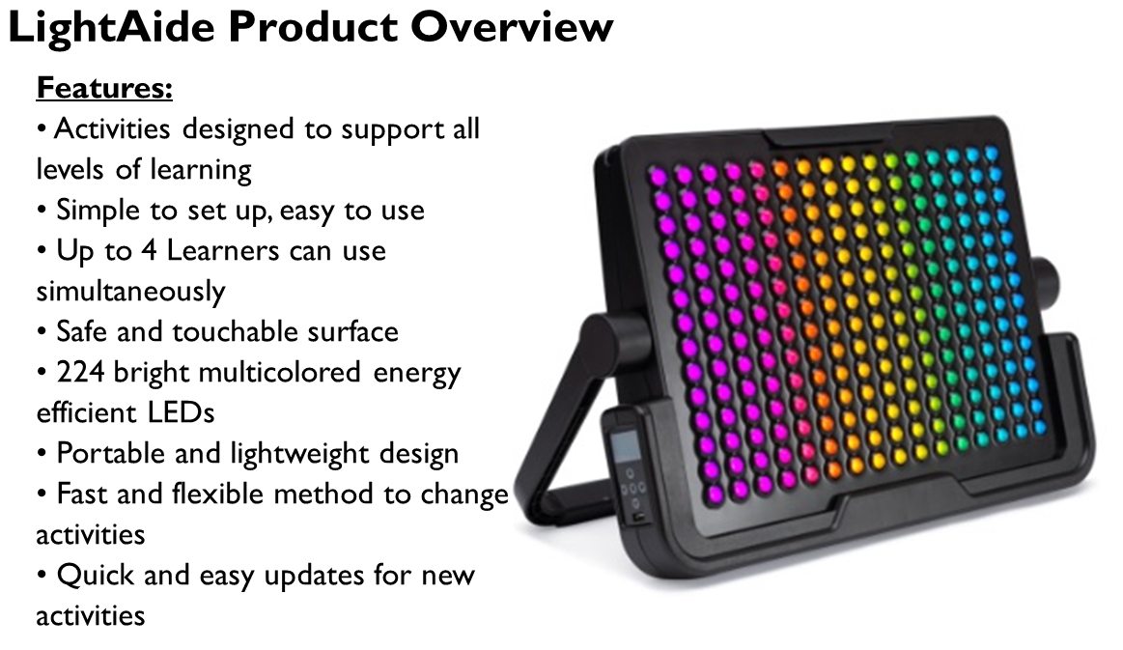

Slide 7
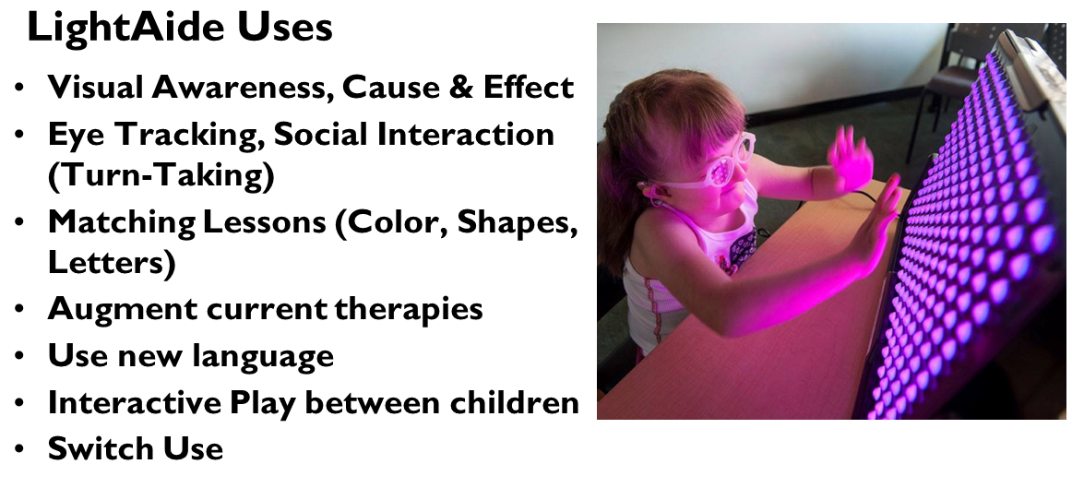

Slide 8
Importance of UDL for LightAide
Based on the neuroscience of learning, the UDL framework includes principles that emphasize three key aspects of pedagogy:
1) The means for the representation of information.
  By offering a broad range and variety of activities that present light in different ways, and providing opportunities to assess visual ability and/or teach concepts and skills, it gives learners various ways of acquiring knowledge.
2) The means for the expression of knowledge.
  By allowing learners or the leader to operate the device via a switch and providing opportunities to use other educational materials (such as manipulatives) to supplement the activity, the LightAide provides learners with alternatives for demonstrating what they know.
3) The means for engagement in learning.
  By offering learners opportunities to work in ways that make sense and are interesting to them (such as choosing activities according to preference, ability, or need), the LightAide taps into learners’ interests, offers challenges, and increases motivation.

Slide 9
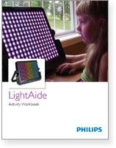
Activity Workbook
Provides information about how each LightAide activity might be used.
Provides information about how each LightAide activity links to Common Core Curriculum & Expanded Core Curriculum

Slide 10

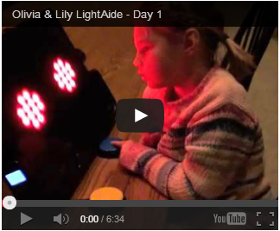
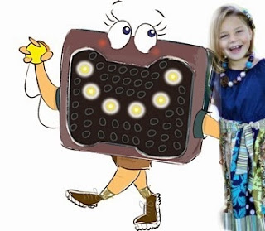
http://bit.ly/19XlFyV
“Olivia has never truly had a toy that she has been attracted to enough to remember to play with. When she came home from school the other day, the first thing that she did was run to the LightAide that is set up on our dining room table. Cognitively, this modality had such an impact on her that she remembered. Wow, I have no words. I possibly just witnessed a miracle!”
www.WonderBaby.org

Slide 11
LightAide User Testing
Presented by
Judy Vesel, Principal Investigator
TERC, Inc.
Judy_Vesel@TERC.edu

Slide 12
Testing Sequence
Working in partnership with Philips, TERC conducted two phases of testing prior to release of the LightAide:
Phase 1: Testing of a prototype version
Phase 2: Testing of a Beta version
For Evaluation Reports and an article resulting from these tests go to http://lightaide.terc.edu/reports/

Slide 13
The Prototype Test
Goals
Collect observation data and user feedback about usability and feasibility.
Elicit suggestions for improvements, additional activities, and support materials.
Report findings.

Slide 14
Prototype Test Activities
Identifying Shapes/Letters
Matching Shapes/Letters
Identifying/Matching Numbers
Building Patterns with Blocks
Tracking Columns/Reading
Taking Turns
Matching Colors
Tracking Rows

Slide 15
Testing Locations
Perkins School for the Blind
Classrooms within visually impaired and Deaf blind programs
Technology room
Therapy rooms
Additional Sites
One home
Professional Center for Child Development in Andover, MA

Slide 16
Testing in Perkins Infant and Toddler Program
Methods
Meeting with parents to describe the evaluation.
Observation of volunteers working one-on-one with individual children using an Observation Guide to record data.

Slide 17
Class-, Technology-, Therapy-room & Home Testing
Methods
Deliver the LightAide. Introduce its set up and use. Review testing requirements. Distribute Set Up Guide and Feedback Form.
Use for a 2-3 week period.
Complete a Feedback/Interview Form.

Slide 18
Test Sample Demographics
Prototype testing involved 13 groups of ~50 learners.
~43 from Perkins representing programs from Infant Toddler through Secondary; the Deafblind program; the Therapy program; and the Technology program.
2 from Home settings.
~5 from a classroom of 5-8 year olds at the Professional Center for Child Development.

Slide 19
Major Prototype Test Findings
The LightAide has the potential to be a useful and valuable assistive tool for use with visually impaired learners in a range of settings.
Suggestions for improvement included reducing the size and weight; developing support materials with information about set up and use and with lists of activities, descriptions of use and extensions.
Brightness of the light, heat emitted, and instability of the switch and controls were concerns.

Slide 20
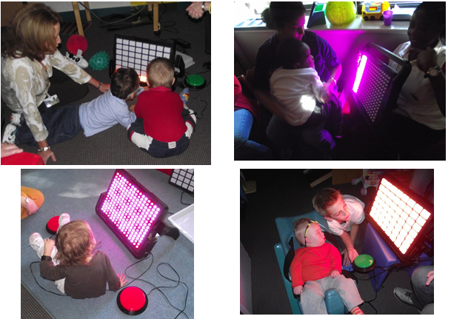
Using the LightAide Prototype

Slide 21
Comments From Testers
“This device enables the child to be in control.”
“One child said the word light for the first time.”
“Several children paid attention or stayed focused longer than with any other toy or device.”
“This device can be used to calm children if they are excited or upset.”
“Light helps children be interested in using their vision.”
“ The LA was wonderful because I could set the lights horizontally and vertically to work on tracking skills.”
“The LA has enough activities to be appropriate for a wide range of levels and needs.”

Slide 22
The Beta Test
Goals
Collect data from first-time users outside of the Perkins community via an online survey following use.
Elicit suggestions for improvements, additional activities, and support materials.
Report findings.

Slide 23
Beta Activities
Development of a User’s Guide and Activity Summaries (by TERC) and preparation of the Beta version (by Philips) were completed prior to testing. A Starter Set of Activities was used for the test.
These were aligned with the standards for
• Mathematics
• English Language Arts
• Expanded Core Curriculum
• Vision Assessment or Therapy

Slide 24
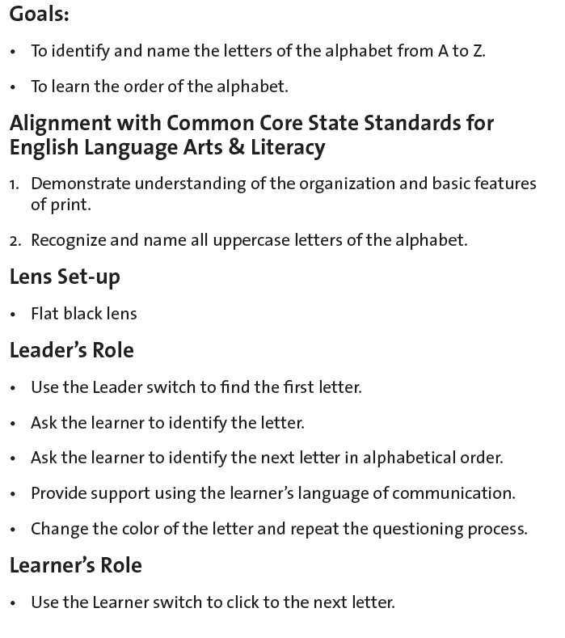
A Sample Activity

Slide 25
Testing Locations
Classrooms within schools for the visually impaired
Library within a school for the visually impaired
Home, school, and/or therapy settings with itinerant teachers of the visually impaired
In the home with parents

Slide 26
Test Methods
Send or give participants a device and direct them to the project Website to download the User Guide, Activity Summary, and participant consent forms.
Use the LightAide for a 2-3 week period (sometimes longer).
Complete an online survey.

Slide 27
Test Sample Demographics
Beta testing involved 8 groups of 20 learners.
5 in a Library setting within a school for the visually impaired
3 in Home settings with parents
7 in Classroom settings within a school for the visually impaired
5 in Classroom settings with an itinerant teacher

Slide 28
Major Beta Test Findings
The LightAide is an engaging and motivating device that complements and enriches instruction. It meets the needs of children with a broad range of vision loss levels and disabilities.
It has the potential to be used for vision assessment, social interaction, practice with tracking light, teaching and learning core-based ELA and math content and mastering ECC skills, and for recreational and therapeutic purposes.

Slide 29
Major Beta Test Findings, Cont’d
3) The Guide and Activity Summaries were useful and helped to set up and operate the device and to select, set up, and implement activities.
4) Teachers and therapists indicated that they would use the LightAide daily, several times a week, or occasionally to evaluate progress, introduce or practice topic or skill.

Slide 30
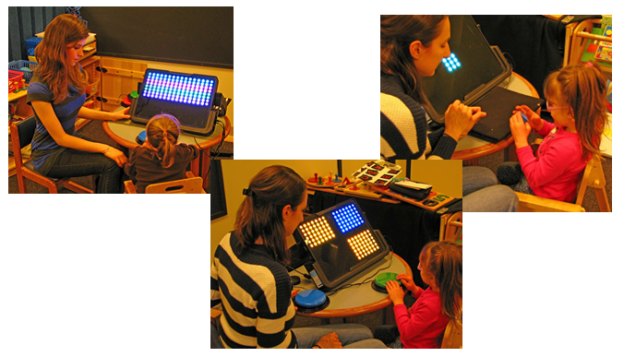
Using the Beta Version

Slide 31
Comments From Beta Testers
“The Guide was very straightforward and helpful.”
“The LightAide was very helpful for each of our students. It met their needs and was a great resource to test their vision as well as assist them in tracking lights.”
“We tried all the options in about 5 minutes, which is a long time for this student.”
“It captured my daughter’s attention immediately. She loved looking at it and loved the cause and effect.”
“Children are interested in it no matter what their ability.”
“It gives students the opportunity to explore something different and try new technology. It is also very motivating.”

Slide 32
Get Involved
TERC is setting up a study of the first commercial version of the LightAide.
The goals of the study are to begin to examine:
1) The potential types of learning gains in ELA, math, and ECC skills that are possible with use.
2) The degree to which use generates engagement, involvement, and interest in learning.
3) Opportunities for therapeutic use.

Slide 33
Get Involved, cont’d.
For more information about the study, contact:
judy_vesel@terc.edu
or
tara_robillard@terc.edu

Slide 34
LightAide Market Opportunities
Presented by
Joe Martini
Perkins Products
joe.martini@perkins.org

Slide 35
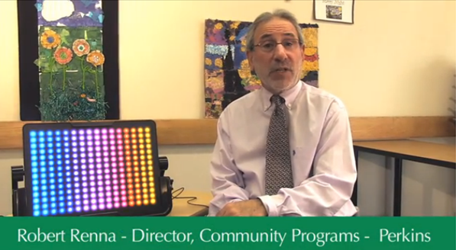
Understanding the Market
Robert Renna comments on wider use of LightAide in education
http://bit.ly/18UVt9w

Slide 36
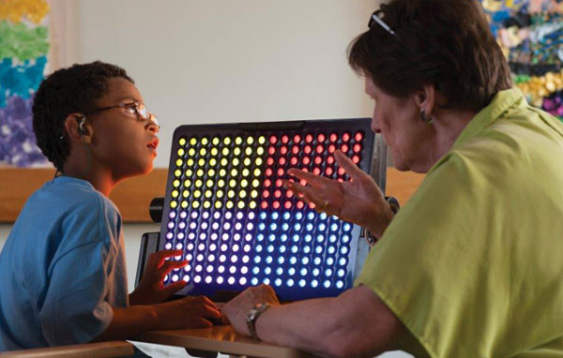
Meeting the needs
“In order to meet their unique needs, students must have specialized services, books and materials … as well as specialized equipment and technology to assure equal access to the core and specialized curricula.”
-AFB White Paper on Inclusion of Students with Visual Impairments
The LightAide is among this specialized technology

Slide 37
National distribution of children with special needs
Disability | Students | Percentage (public school enrollment)
Learning disabilities (LD) | 2,431,000 | 4.9%
Speech or Language Impairment (SI) | 1,416,000 | 2.9%
Other health impairment (OHI) | 689,000 | 1.4%
Intellectually Disabled | 463,000 | 0.9%
Emotional disturbance(ED) | 407,000 | 0.8%
Autism | 378,000 | 0.8%
Developmental delay | 368,000 | 0.7%
Multiple disabilities | 131,000 | 0.3%
Hearing impairment (HI) | 79,000 | 0.2%
Orthopedic impairment (OI) | 65,000 | 0.1%
Visual impairment (VI) | 29,000 | 0.1%
Traumatic brain injury (TBI) | 25,000 | 0.1%
Deaf & blindness | 2,000 | 0.0%
SOURCE: U.S. Department of Education, National Center for Education Statistics (2012). Digest of Education Statistics, 2011 (NCES 2012-001), Chapter 2.^{[17]}

Slide 38
Reaching children with special needs through
Children with special needs
State-wide & National Programs
Professional Outreach
Consumer Outreach
Conferences and Exhibitions
Print & Social Media
Word of mouth

Slide 39
State-wide and National Program Outreach
Special Education Departments
TVI/O&M
Programs
Schools for
the Blind & For Special Needs
Early
Intervention
Programs

Slide 40
Professional Outreach
Professional & Academic Groups, Conferences and Organizations
TVI & SPED Teachers
Low vision, Occupational, & Behavior Therapists

Slide 41
Consumer Outreach
Parent/families of children with disabilities
Parent to parent organizations
On-line magazines, newsletters, Blogs, YouTube Videos & Facebook

Slide 42
What we are learning about the LightAide for new emerging markets
The LightAide has receive significant interest from teachers who are working with children who have Cortical Visual Impairment (CVI)
Occupational therapists suggest that persons who have experienced traumatic brain injury or stroke may benefit
Potentially, the LightAide could be used with seniors with dementia

Slide 43
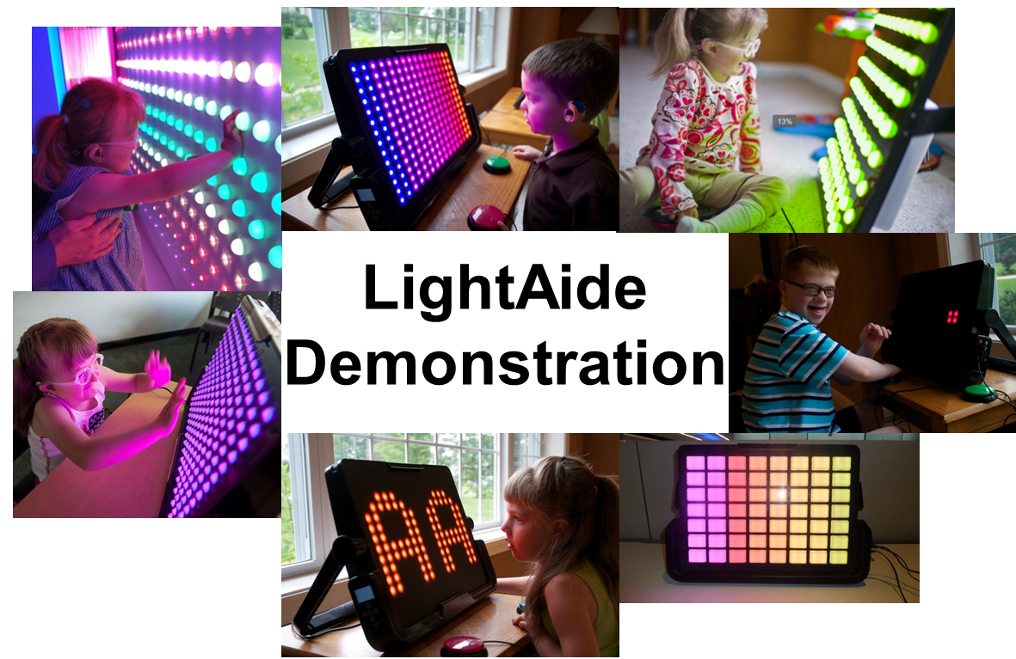

Slide 44
Thank you for attending this session
CEUs – Session Code: SI-04
  More info at: www.atia.org/CEU
  For ACVREP, AOTA and ASHA CEUs, hand in completed Attendance Forms to REGISTRATION DESK at the end of the conference. Please note there is a $15 fee for AOTA CEUs.
  For general CEUs, apply online with The AAC Institute: www.aacinstitute.org
Session Evaluation
  Please help us improve the quality of our conference by completing your session evaluation form.
  Completed evaluation forms should be submitted as you exit or to staff at the registration desk.
Handouts
  Handouts are available at: www.atia.org/orlandohandouts
  Handout link remains live for 3 months after the conference ends.

